Slide 1
International study centre
Functions, Loops, Condition & Data Types

Slide 2
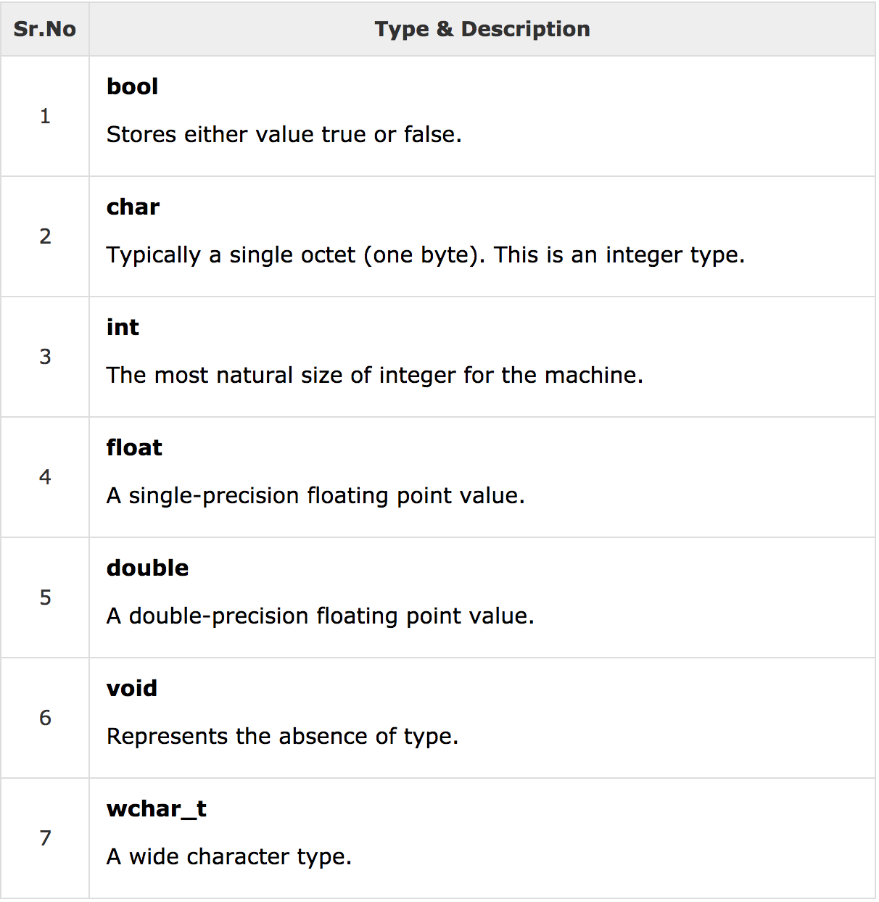
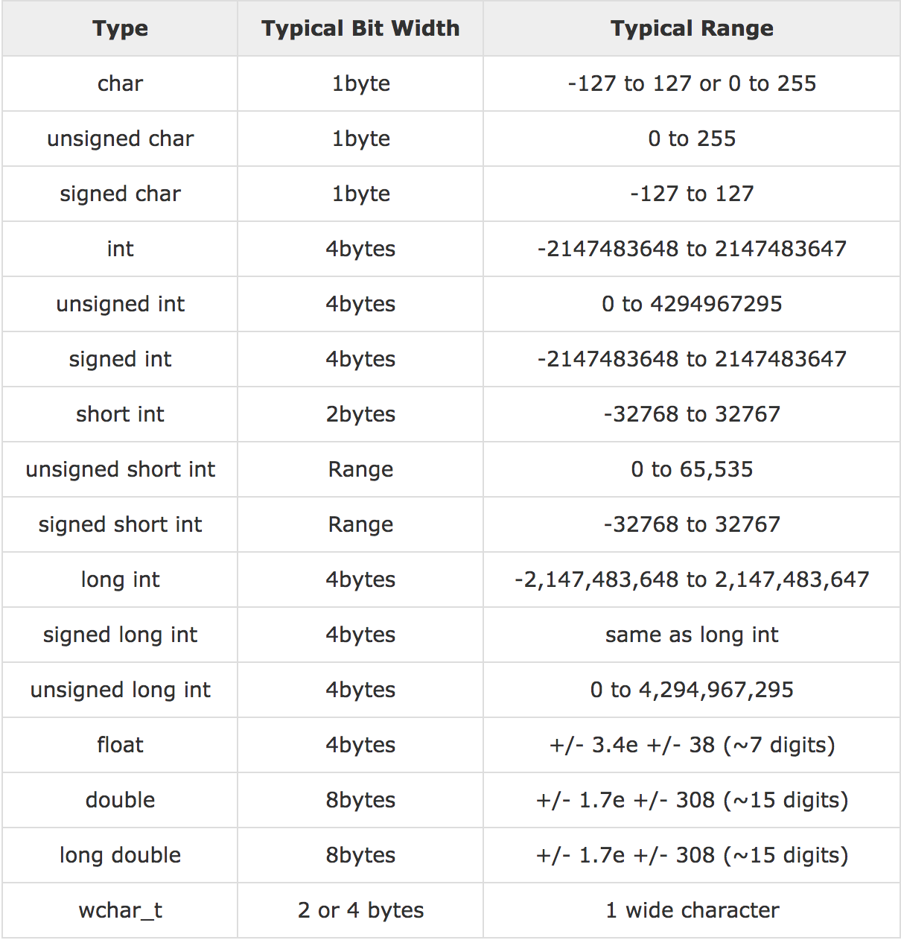
Data Types

Slide 3
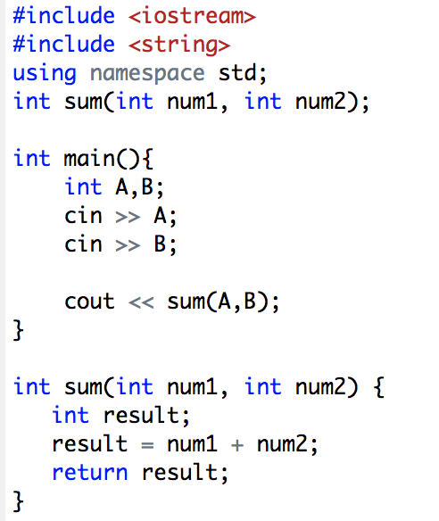
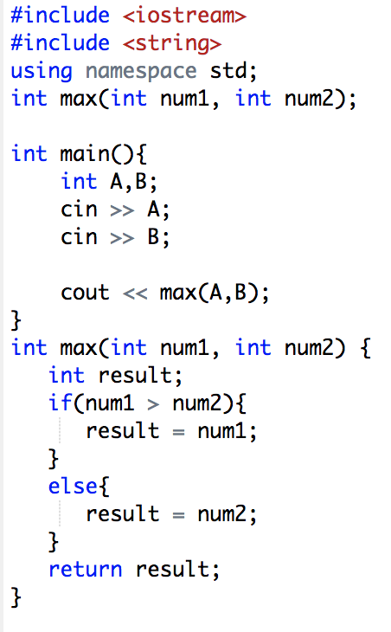
Functions
return_type function_name( parameter list ) {
body of the function
}

Slide 4
Condition (if)
int a = 100; // check the boolean condition
if( a == 10 ) { // if condition is true then print the following cout << "Value of a is 10" << endl;
}
else if( a == 20 ) { // if else if condition is true
cout << "Value of a is 20" << endl;
} else if( a == 30 ) { // if else if condition is true
cout << "Value of a is 30" << endl;
} else { // if none of the conditions is true
cout << "Value of a is not matching" << endl;
}
cout << "Exact value of a is : " << a << endl;

Slide 5
Loops
while( a < 20 ) {
cout << "value of a: " << a << endl;
a++;
}
for( int a = 10; a < 20; a = a + 1 ) {
cout << "value of a: " << a << endl;
}
do {
cout << "value of a: " << a << endl;
a = a + 1;
} while( a < 20 );

Slide 6
Any Questions ?

